Slide 1
Telescience Update
Shinji Shimojo
Fang-Pang Lin

Slide 2
Telescience working group on PRAGMA
Co-lead by me and Fang-Pang Lin
data acquisition, sharing, analysis and visualizing by (remote) observation using sensors and devices
1. Environment:
a. Common Test Platform:
b. Common Architecture
i. Middleware
Portals, Data Turbine
ii. Viz Wall (TDW) , starCAVE, HOPE, …
covise, sage
iii. Real time video streaming
iv sensors
2. Applications:
a. General Targets:
i. On demand real-time streaming.
ii. Distributed measurement
iii. Scalable, adaptive, reusable…
b. Applications: Bio-medical, Earthquake, Flood Control,
Meteorological, Agricultural, Ecological, Oceanographic,
GeoScience, environmental monitoring for Urban Area
c. Educational Component
PRIME and PRIUS

Slide 3
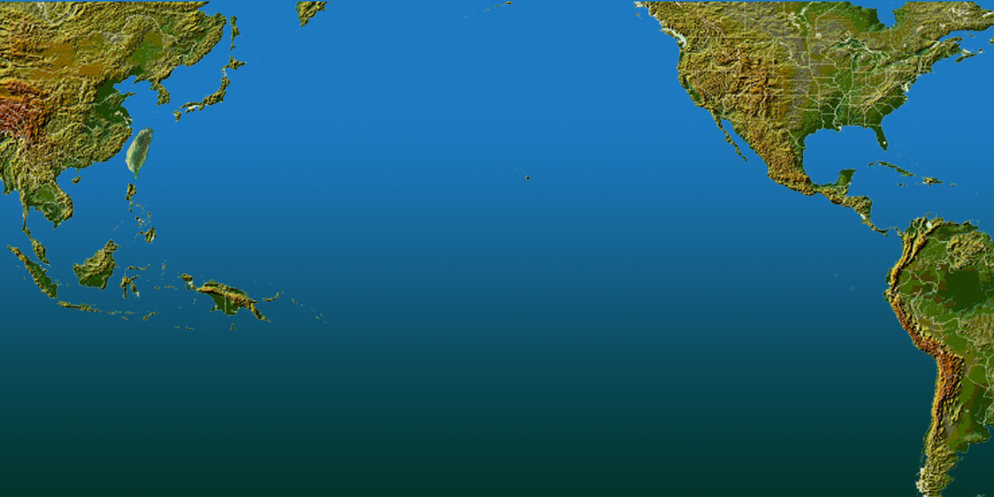
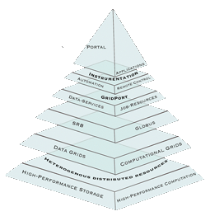
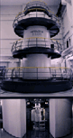
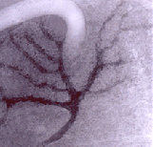
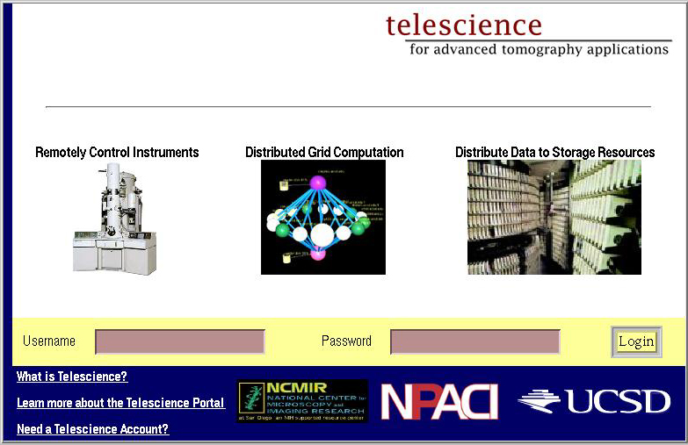
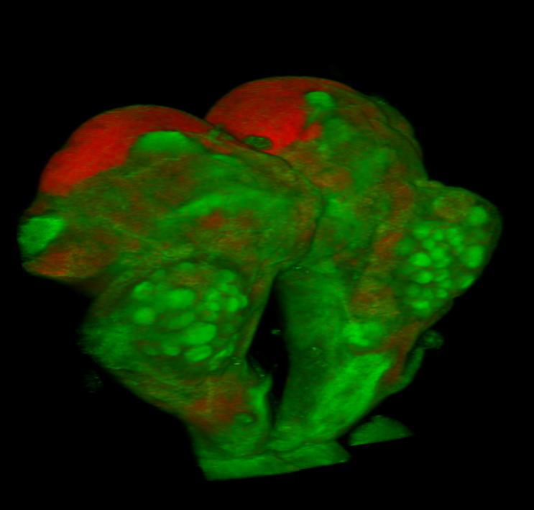
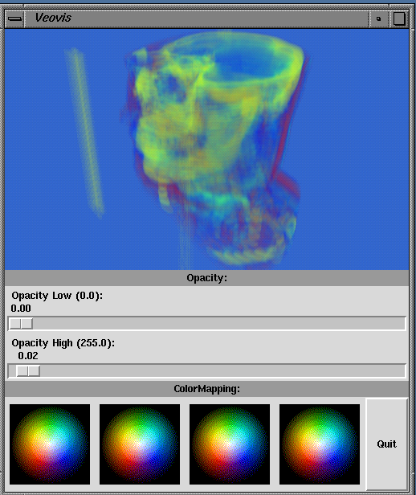
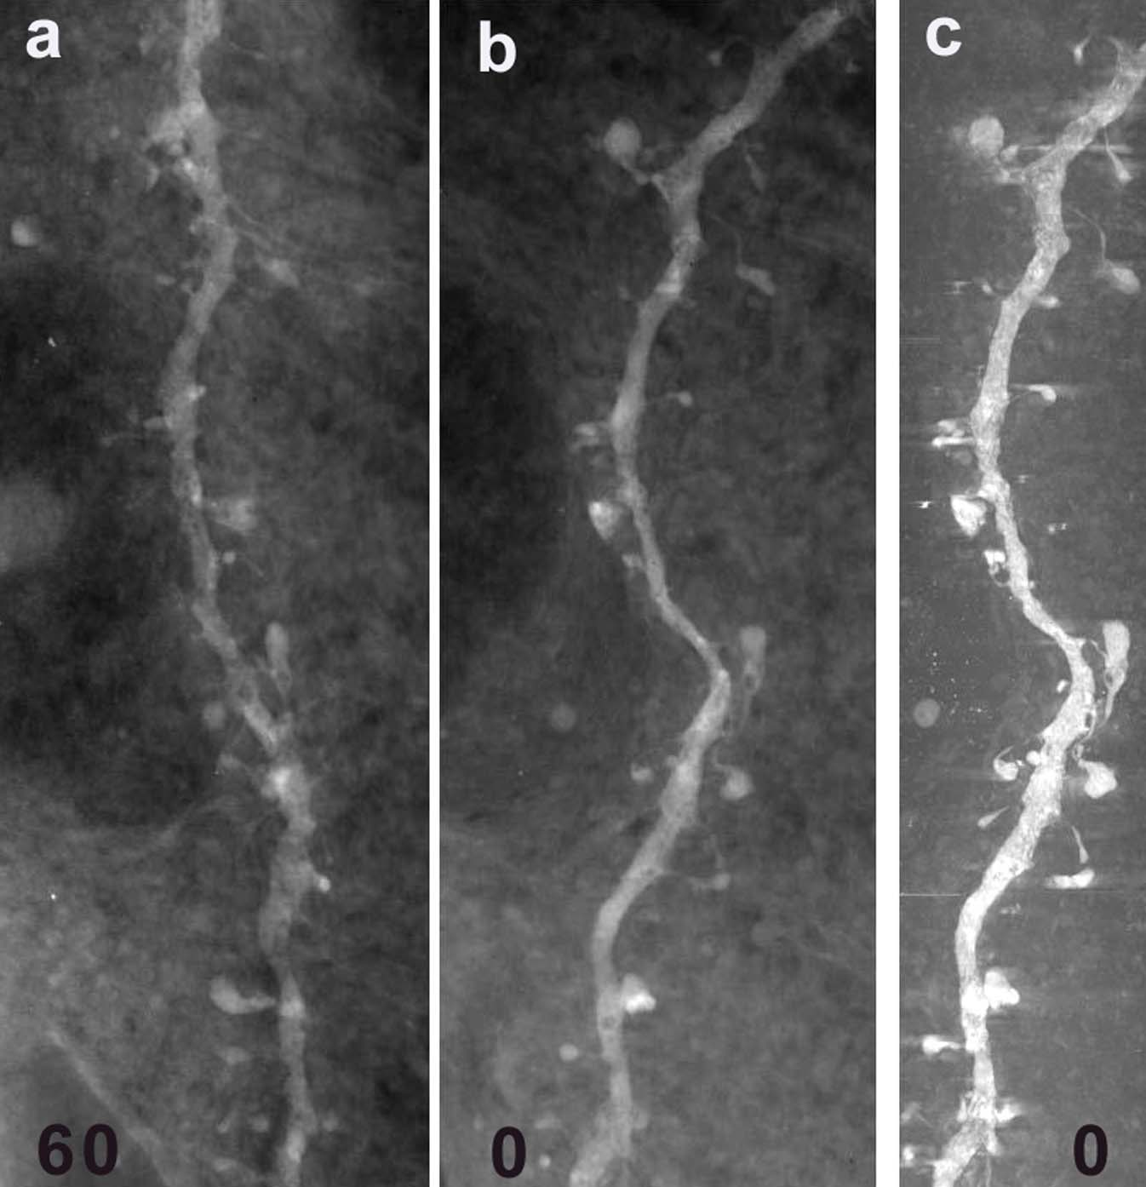
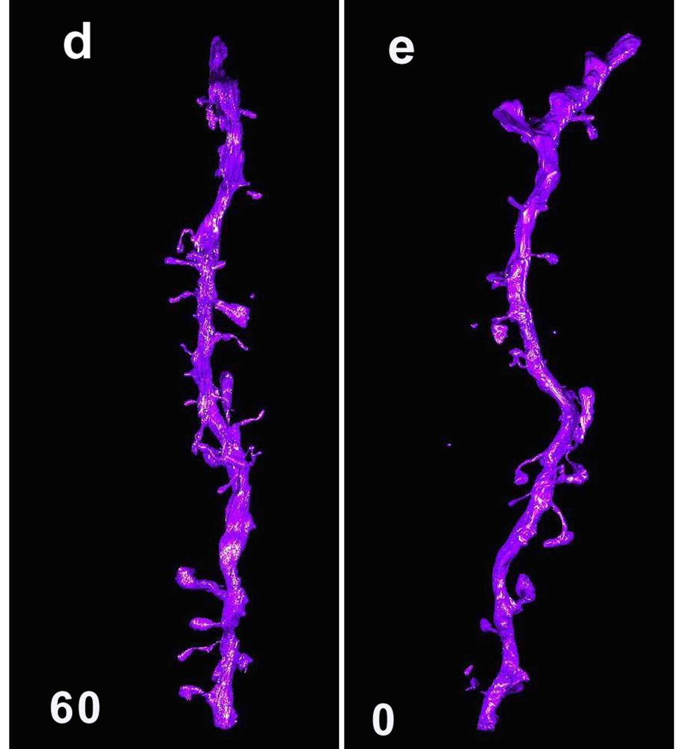
Tele-science on Tomography （Osaka U、NCHC、UCSD）
Pacific
Rim
Application
Grid
Middleware
Assembly
SDSC
Osaka U.
NCHC
NCHC will host 5th PRAGMA in Oct. 2003
iGrid 02, joint demo, Sep. 2002
SC 02, HPC Challenge, Nov. 2002
3
Provided by Dr. Naoko Yamada (NCMIR)

Slide 4
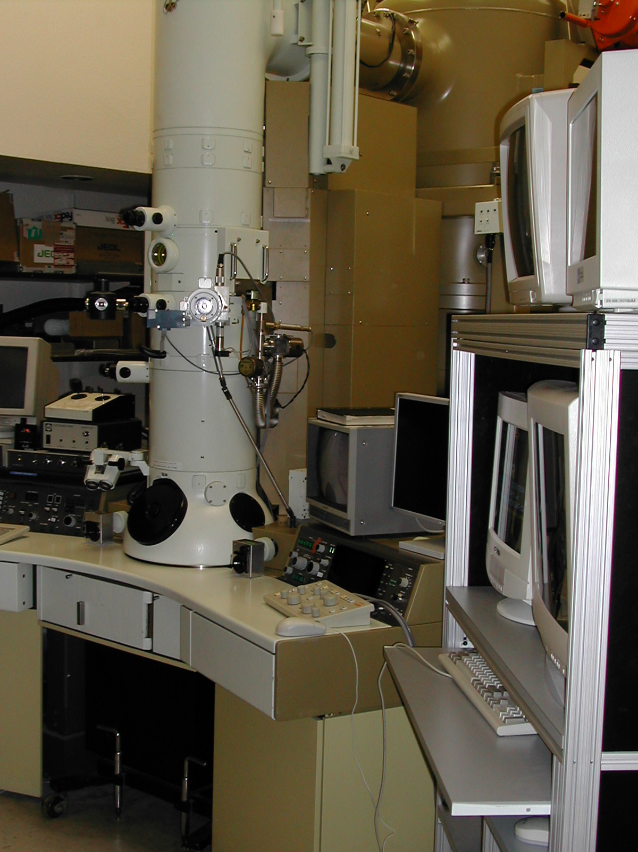
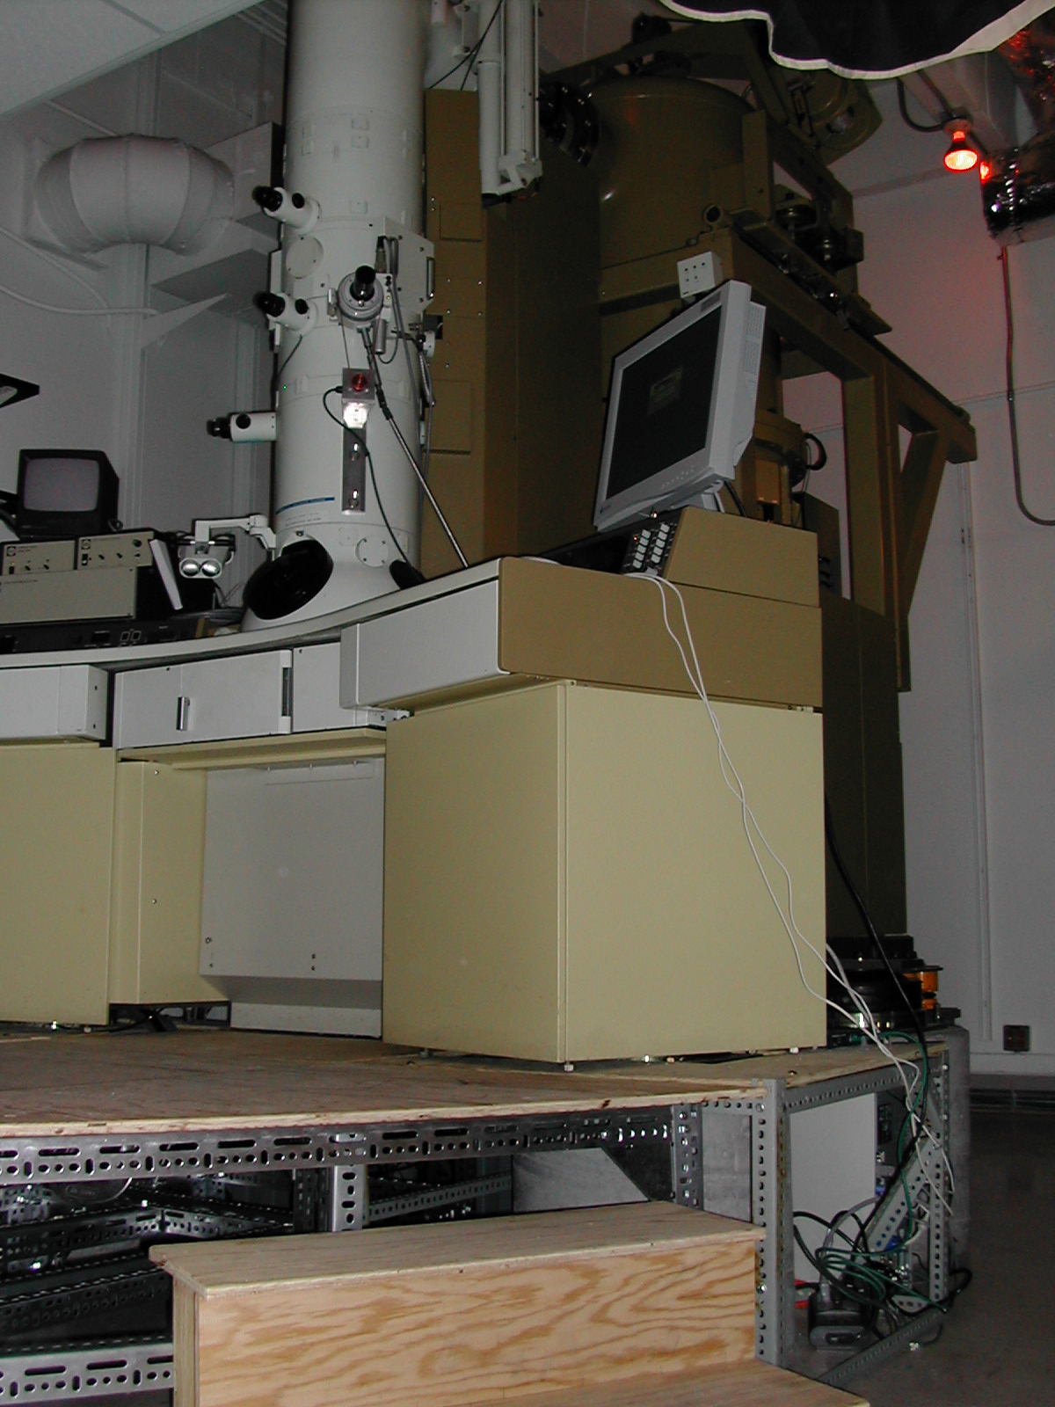
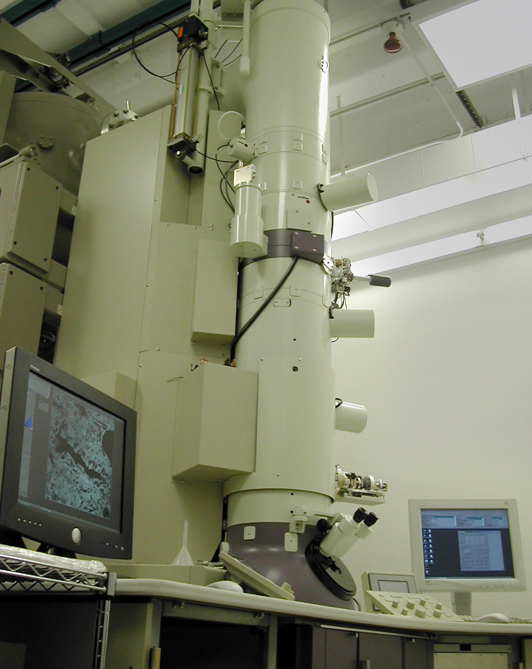
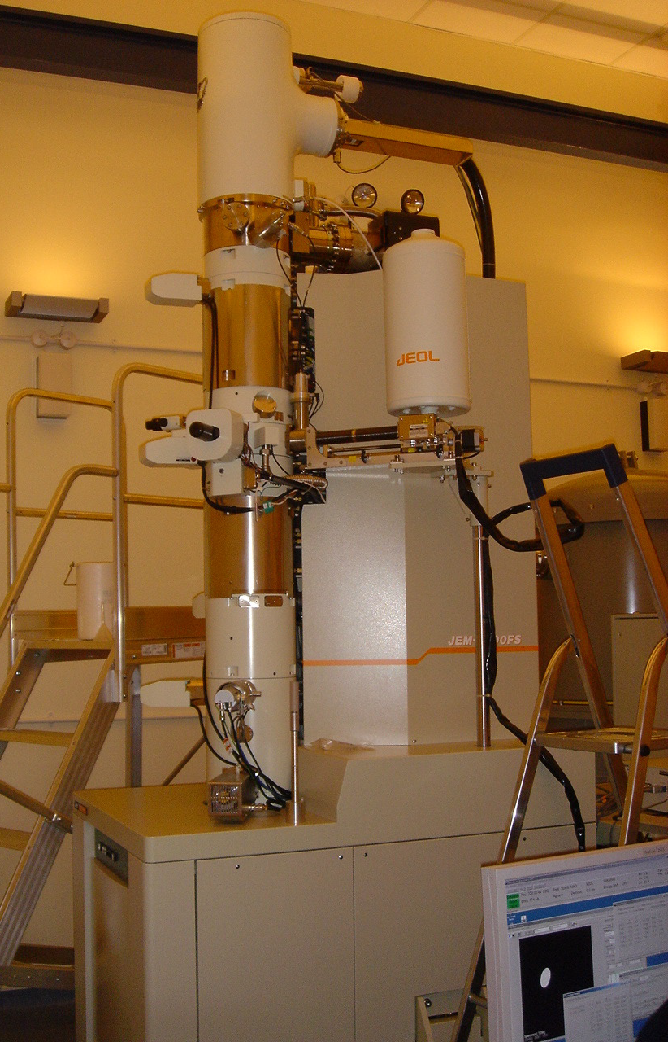
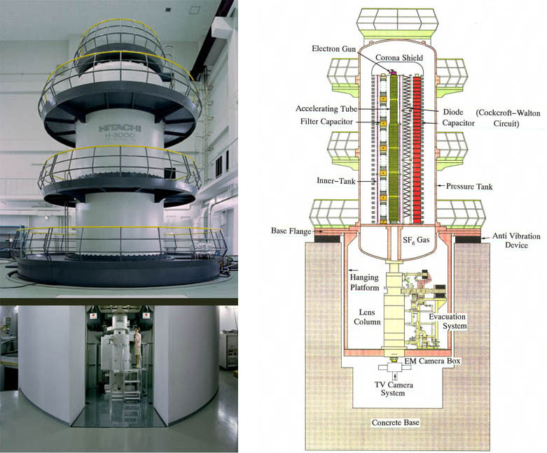
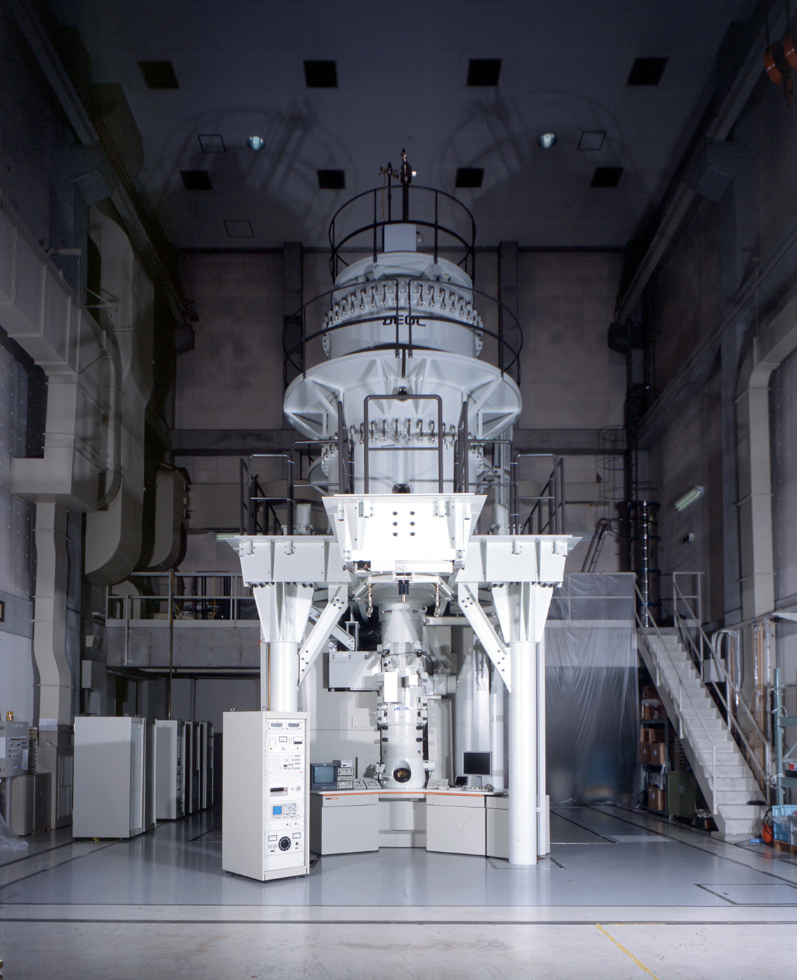
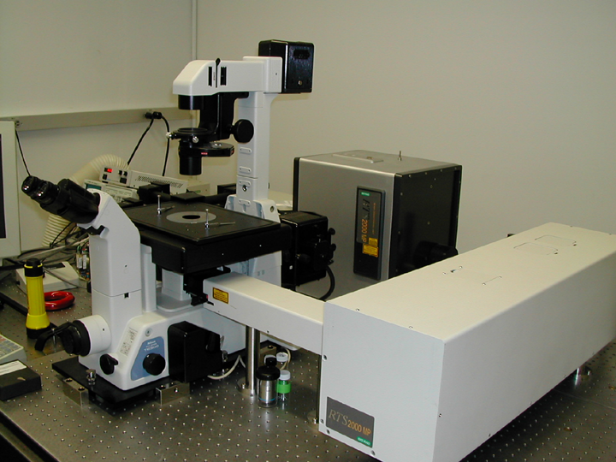
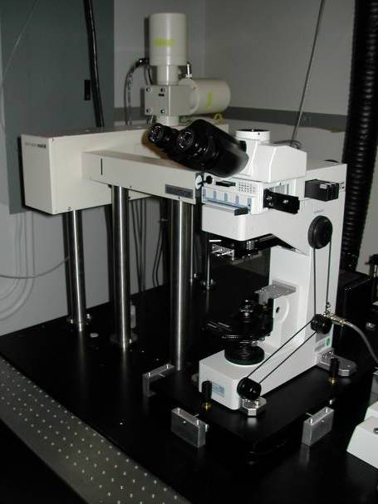
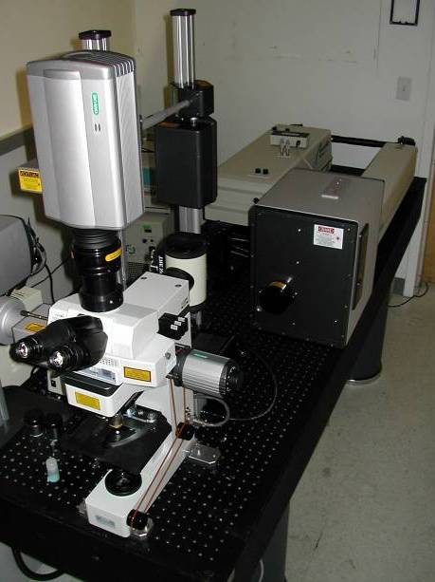
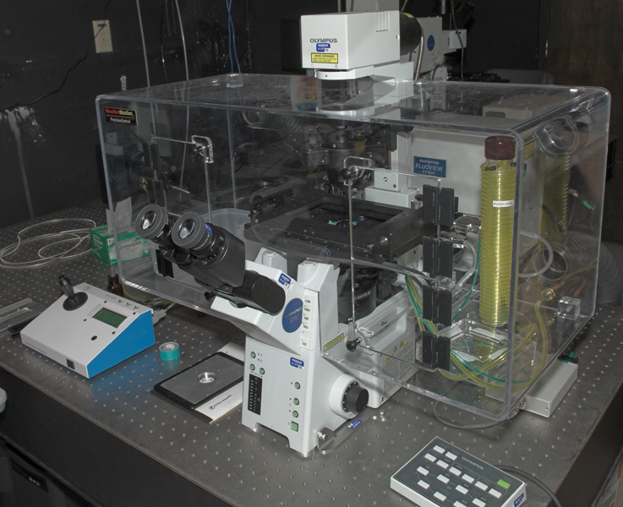
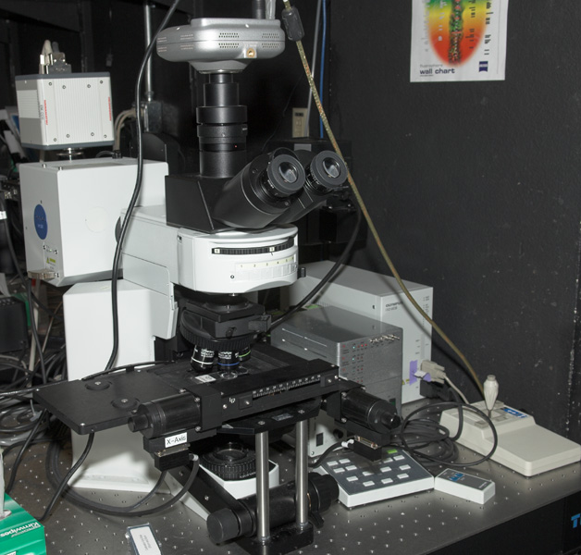
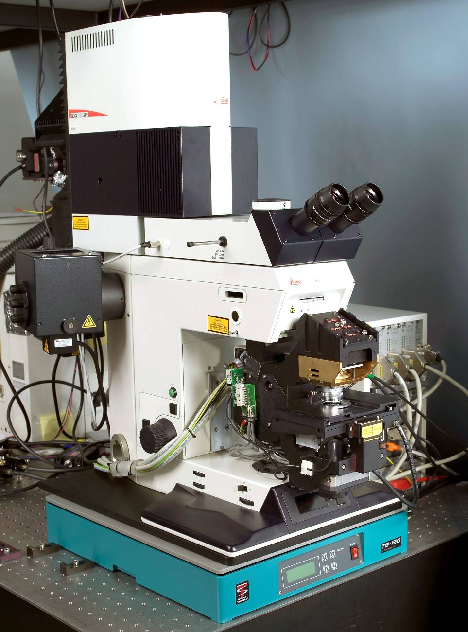
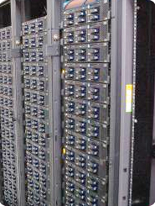
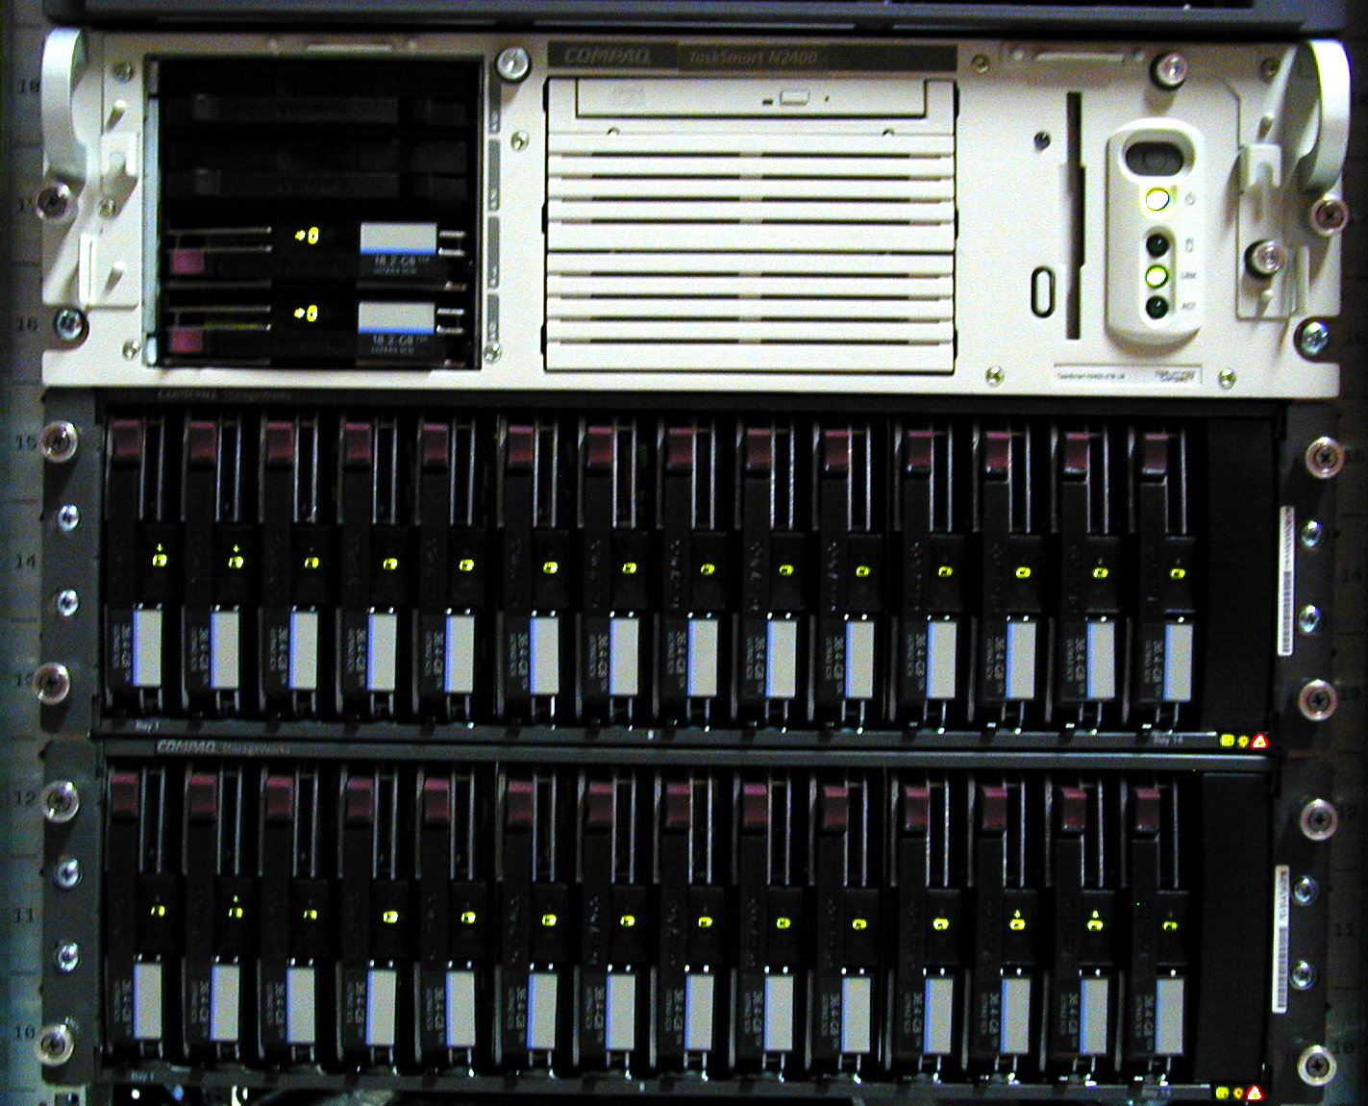
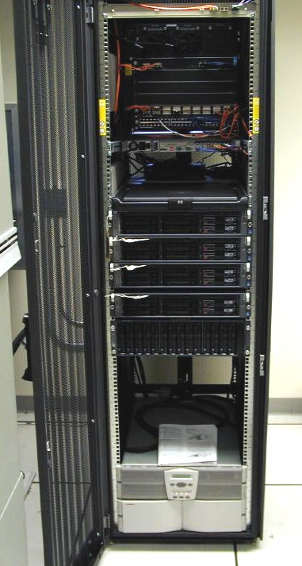
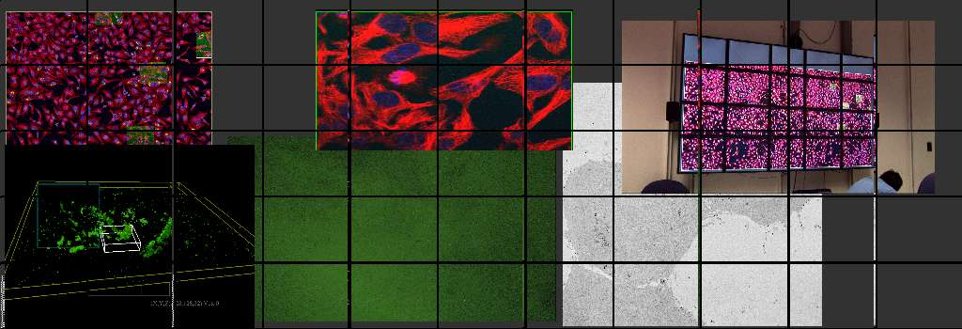
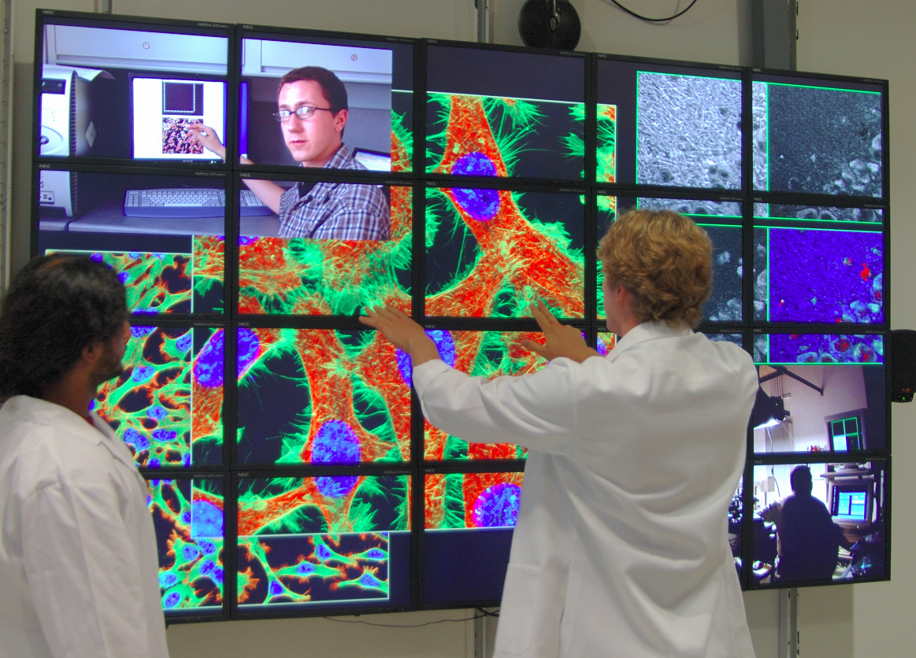
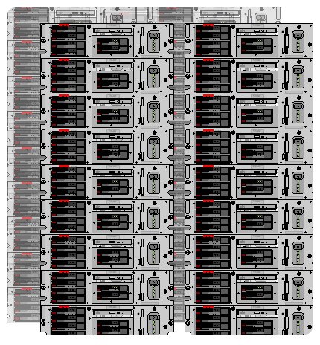
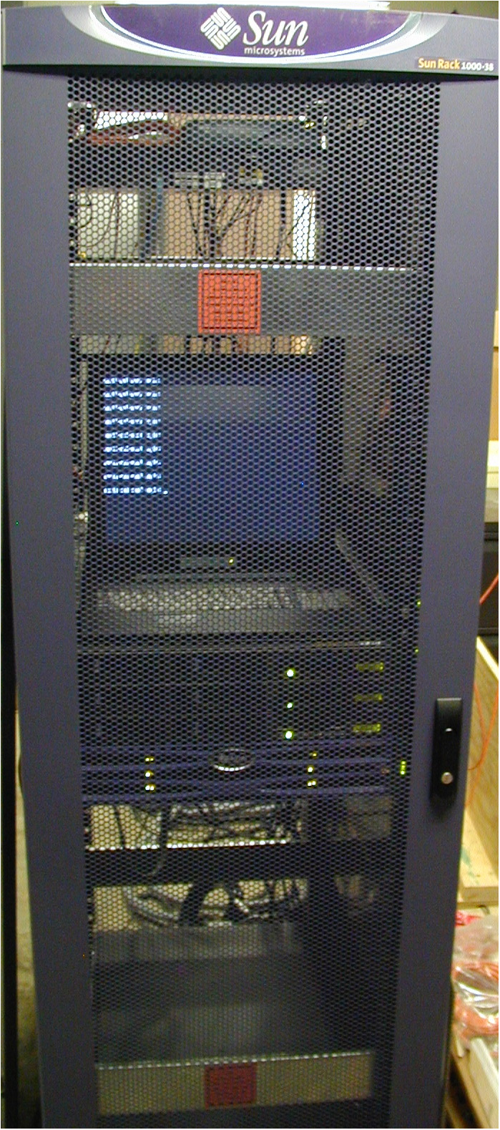
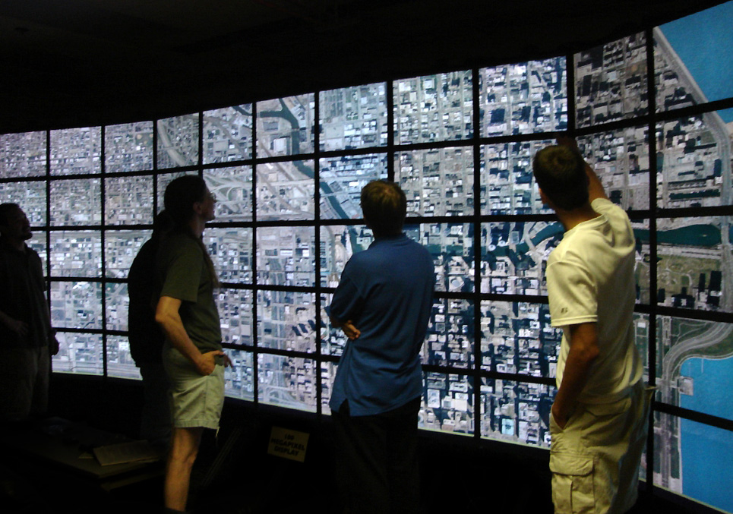
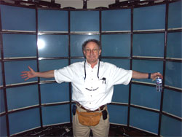
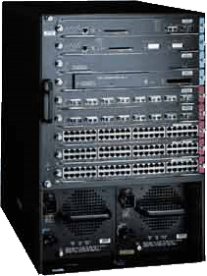







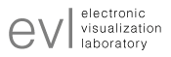
Internal Imaging Instruments
External Imaging Instruments
Jeol 4000#1
Jeol 4000 #2
Jeol 3200
Electron Microscopes
Jeol 2000
Oxford, U.K.
Jeol 3Mev
Osaka, Japan
Jeol 1.25Mev
Daejon, South Korea
Radiance
Radiance
Radiance
Olympus
4Pi Microscope
Bar Harbor, Jackson
Light Microscopes
Computation and Storage Resources
Viz Resources
Storage
NCMIR
Calit2
Clusters
HDTV Trans.
KDDI
NTT
Research Channel
BIRN Rack
Optical Networking
CCDB
EVL
Source: Mark Ellisman

Slide 5
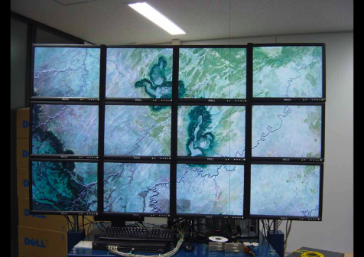
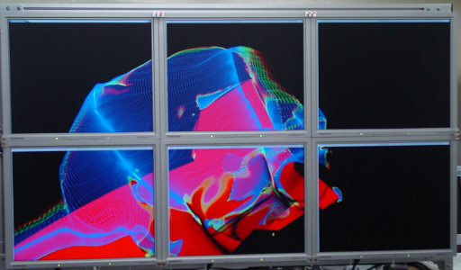
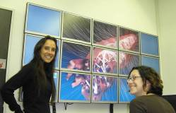
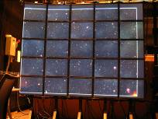
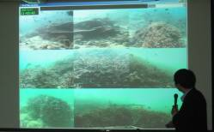
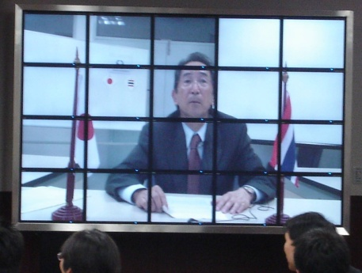
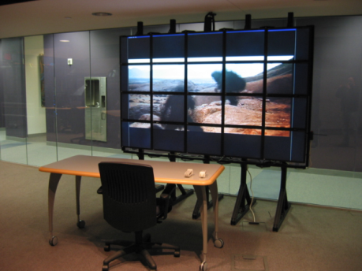
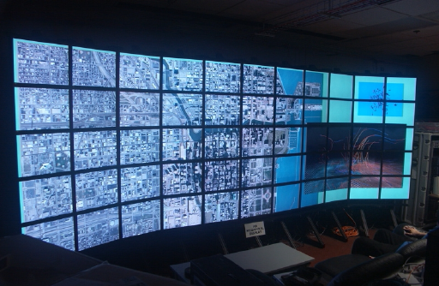
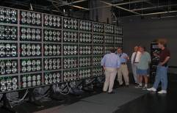
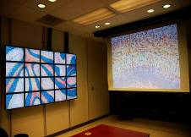
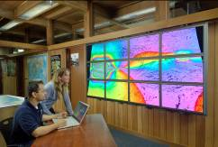
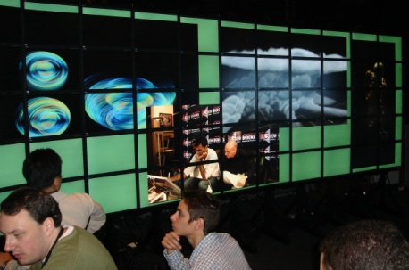


Step Two: Build a Rocks / SAGE OptIPortal
AIST
KISTI
UZurich
CNIC
NCHC
NCSA & TRECC
Osaka U
UIC
Calit2@UCI
Calit2@UCSD
NCMIR@UCSD
SIO@UCSD
Source: Larry Smarr
Notes:
5
Maybe add another slide to indicate which science groups are using this or working with this

Slide 6
What is the plan for this year
Make 10Gbps enabled TD
Osaka U, NICT, KISTI, NCHC, Kyoto U
PRIME project
3D teleexistance project
Joint WG with GeoScience WG in PRAGMA 15
Urban environment monitoring
Data Processing, Sharing, Visualization
New Project
Parallel rendering, Interaction
Cultural Heritage

Slide 7
Issues
Joint WG with GeoScience: Need more time
Let’s do it again
Demo for SC08
Push from Education
Push From education: HD lecture series = Part of Pragma Outreach

Slide 8
What happens after PRAGMA 15
SC08
Peta-scale Visualization Platform
Many TDW
Used for Large scale Visualization and HD streaming
Sensor net activity
Pragma Institute in Taichu
More Collaboration with Geo
Start of new collaboration with e-Culture
Murpa seminar on Feb.
Trial for HD multicasting
Exibition on Knowledge Captal
TDW for 4K, Large Scale volume rendering, Cultural Heritage, HD animation
Demo at KISTI

Slide 9
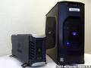

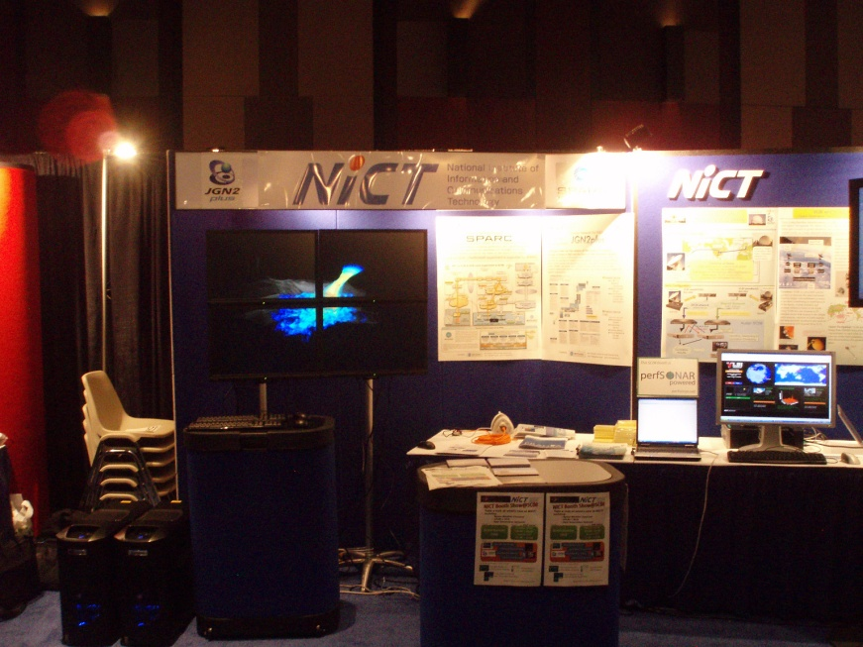
Peta-scale Visualization Platform (CMC and NICT)
Scalable TDW with GPGPU 10G-Cluster
Asterism ADT08 (SuseLinux64)
Quad Core Opteron 2350 x 2 (8core)
Chelsio 10G ether S320E-CXA
32GByte DDR2 memory
Quadro FX4600/4700
24inch WUXGA display
L3 switch
HP Procurve 6400cl-6XG
10GbE X2-SC LR Optic

Slide 10
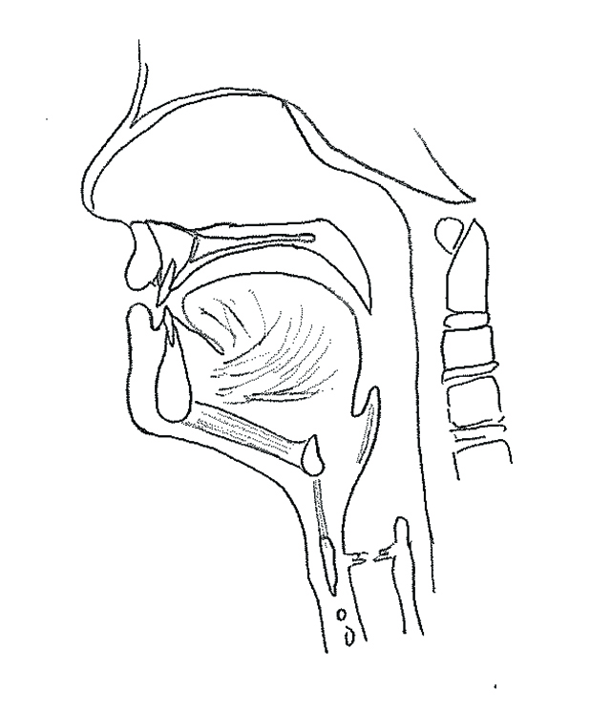
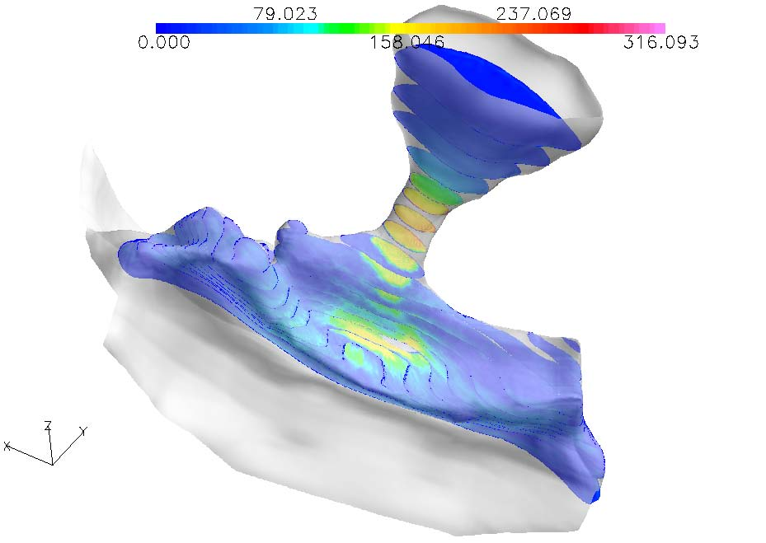
Tera-scale Volume data
Unstructured Hexahedron Mesh
72million mesh
Result data set: 4.2GByte/1step
Human vocal tube
Calculation condition
T2K
64 nodes via Myrinet 10G
(Quad- core Opteron x 4)
Total 1024 cores
SX9
4 nodes via IXS 16.4G
Total 64 CPUs
CFD Simulation Result
Simulated area
=
禁帯出
AIR

Slide 11


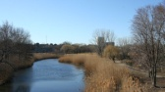
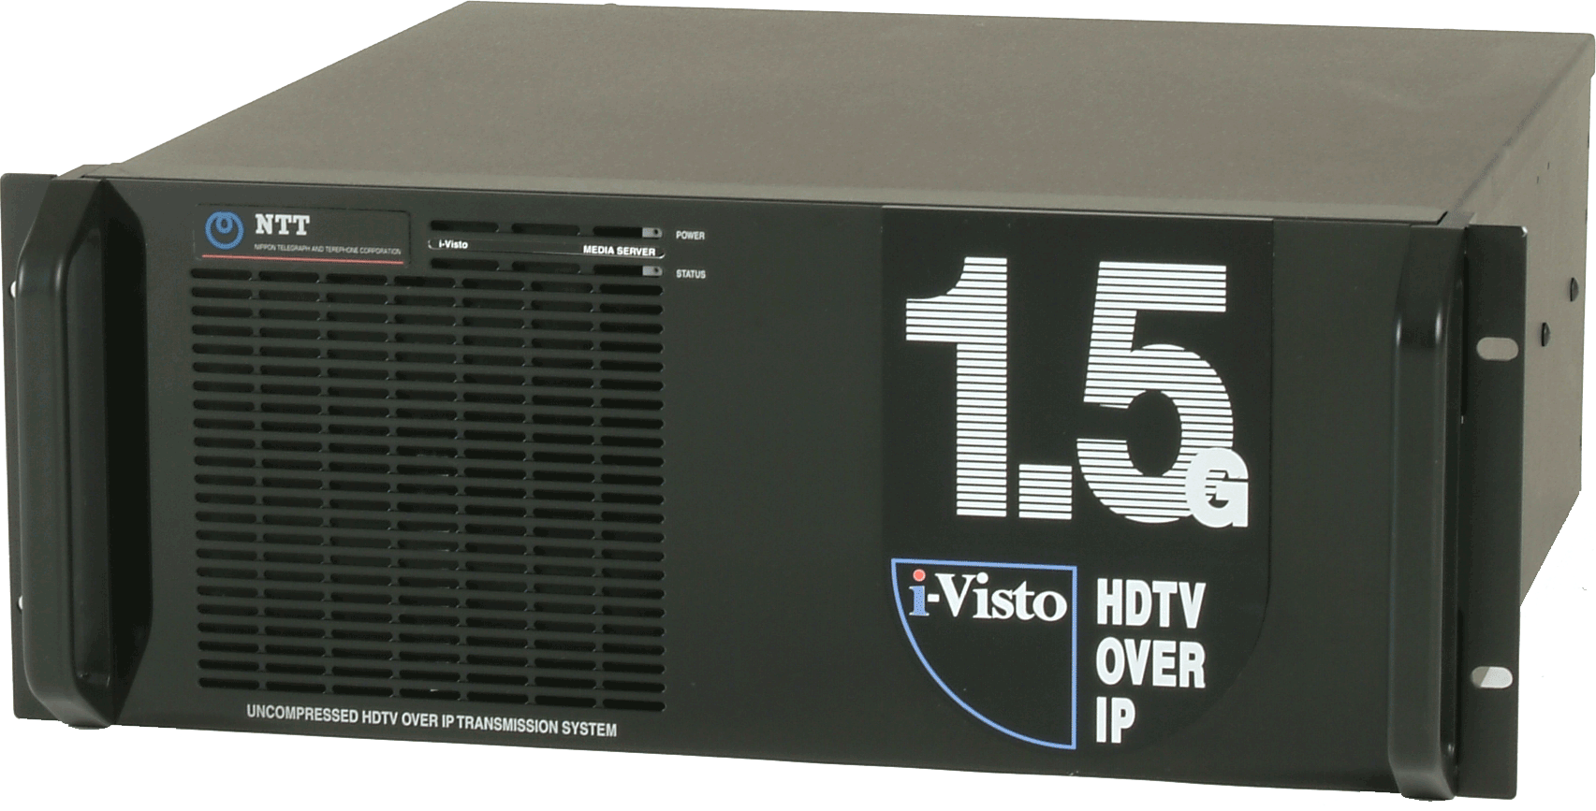











Uncompressed HDTV on Tiled Display Wall
and 10-Gbps High-Accuracy Distributed Network Monitoring
NTT Network Innovation Laboratories
Cybermedia Center, Osaka University
Uncompressed HDTV on Tiled Display Wall:
10-Gbps High-Accuracy Distributed Network Monitoring:
Osaka University and NTT have developed an uncompressed HDTV streaming system for a tiled display wall. The system can receive HDTV streams from the NTT i-Visto system.
NTT has also developed a protocol converter, which enables interoperation between i-Visto and iHD1500 developed by the University of Washington.
NTT promotes standardization of the protocol to facilitate the wide-ranging use of uncompressed HDTV transmission.
NTT has developed a 10Gbps network interface card with high- accuracy traffic-measurement capabilities, which enables distributed network monitoring systems using an application-coexistent monitoring scheme.
In this booth, we demonstrate the measurement of traffic burstiness and delays using 100-ns fine-resolution packet time-stamps appended to i-Visto streams. The characteristic differences are shown on two different networks from Japan to the United States using deployed systems in Seattle and Austin.
Tiled Display
GPS
10-Gbps monitoring system
high-speed
IP network
i-Visto
by NTT
tiled display wall
Seattle
protocol
converter
Osaka
Los Angels
Austin
iHD1500 by University of Washington
IP/UDP
data
TS
XG-2
by NTT-AT
HD-SDI
monitor
i-Visto
i-Visto packet
with time-stamp
This work was partially supported by the National Institute of Information and Communications Technology.
Contact: NTT Network Innovation Laboratories
E-mail: sc08@lab.ntt.co.jp

Slide 12









Live E! on P2P Platform “PIAX”
We implemented Live E! Agent on PIAX. Live E! Agent retrieves and stores Live E! data.
We’ll test and implement the other agents like “forecast” agents.
Live E! Agent on PIAX
2008/9現在
Web I/F
SOAP Port
Sensor Data
Storage
Live E! server
Application
Live E! sensor
Web Service
Agents Home
glue
Auth, Secure Support
PIAX Overlay Network
P2P Overlay
LL-Net
PIAX
DHT
RPC / Streaming Wrapper
Physical Network

Slide 13


Telescience – New elements (led by Shinji)
E-Culture via Sensor Network/4K-HD/TDW
GLEON met Geo WG (Tim, Ryosuke) and later in GLEON 8 & PRAGMA
Taiwan’s new Ocean & Space Research Programs
Water Resource Agency invited
Center of Excellence (CEPERC) update (led by Whey-Fone)
Bioscience – Infectious Flu (led by Wilfred)
Resources – Cloud on the rise (led by Yoshio)
Cloud Computing (Phil)
DRBL/Clonzilla (Steven)

Slide 14





Digital Clinical Chart of a Work of Art
for
a Museum of the Future
M a u r i z i o S e r a c i n i
Director of CISA3
Center of Interdisciplinary Science for Art, Architecture and Archaeology
at CALIT2
University of California, San Diego
December 1, 2008

Slide 15

Multispectral Diagnostics Imaging
Source: Maurizio Seracini

Slide 16


GLEON 8 Meeting
Monday 2 - Friday 6 February 2009* The University of Waikato, Hamilton, New Zealand
Lake Rotorua, New Zealand

Slide 17





HDV@ Kenting NCHC, NMMBA, UCSD, TORI
NCHC, Hsinchu (4M, 1M)
NMMBA, Kenting (10M)
http://140.110.31.130/SC/
PRAGMA 14 March 2008 Taiwan
CREON Integration Meeting Started

Slide 18


Coral Reef Observation Station at Ochied Island
Site
(Yei-Yu)

Slide 19

Source: Whey-Fone Tsai

Slide 20



TDWs on Knowledge Captial Exibition
Mar 12,13 2009

Slide 21





Slide 22
Telescience breakout
Day1 Telescience, and E-culture
Eisaku Sakane “A design and implementation of a data management and visualization system towards online microscopic imaging”
Fang-Pang Lin “Cultural heritage in NPM”
CHIKAMA Masaki, "Renaissane painting analyzed by Terahertz light on Tiled Display Wall”
Naohisa Sakamoto, "Visualization of Large and Complex Volume Dataset on TDW”
JongWon Kim, "Unified Meeting Space for Media-centric Networked Collaboration”
Day 1 joint with GeoScience
Young-Gyu Park, "Introduction of high performance computing and visualization at Korea Ocean Research and Development Institute”
Fang-Pang Lin “GLEON and CREON”
Mathew Grant Allan (University of Waikato, NZ)REMOTE SENSING OF WATER QUALITY AND TEMPERATURE IN LAKES
Ryosuke NAKAMURA (AIST, JAPAN)Integration of satellite imagery and in-situ ground observations
Young-Kwang Yeon, Korea Geoscience and Mineral ResourcesMathew Grant Allan, University of Waikato
QinHai Lake by Baoping Yan

Slide 23
Discussion
Infrastructure for 2D/3D
SAGE, CGLX, KVT, etc.
It is proven in demo that Common infrastructure is important
Joint with Geo and tele-science
Models
tidal model
3D ecological Model
Data Integration and standard
OGC standard and KML
Computational Power
Parallelization of CODE
Visualization Platform
Google Earth
Authentication, access control

Slide 24
Home work
Joint working group with Geo, telescience and Resource
Data Integration
AAA service
Virtualization ?
Joint demo with Geo WG for next Pragma
Collaborative Demo for e-culture
Prime student

